Slide 1



D.E.E.P.
Impact
Disgruntled Employee Exploitation Program

Slide 2
Overview
1
2
Team Introduction
Scenario
3
4
Incident responce & Complience
Infrastructure

Slide 3
D.E.E.P Impact
Team

Slide 4
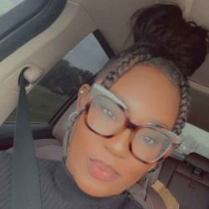


Breanna Taylor
8 year Air Force Veteran
4 Electronic Maintenance Techician
Security + (2024)
https://github.com/Btaylor007
www.linkedin.com/in/
breanna-t-341637296
e

Slide 5
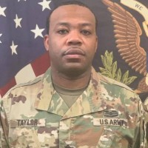
Tommy S Taylor II
20 year military veteran
ITIL, Cyber Security Analyst, Fiber Optics
Bachalors degree in Information System Security
American Military Univeristy
Professional Exeriance
Cable Installer (Army) First Sergeant (Army)
Return to tech and Cyber Security
Code Fellows, ITF+(2023), Net+ & Sec+ (Exp. 2024)
https://github.com/taylortommy23
https://www.linkedin.com/in/taylortommy/

Slide 6

Festus
Oguhebe, Jr.
15 years Army/Air Force veteran;
Military Intelligence officer
Medical Logistics and Readiness Officer
Hold Masters degrees in MBA and Healthcare Administration
University of Alabama at Birmingham
ITF Cert., Working on Network Cert
https://github.com/focodecided/
https://www.linkedin.com/in/festus-oguhebe-jr-foco

Slide 7
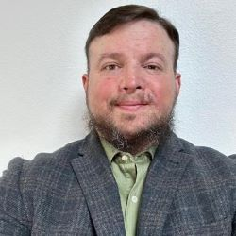
David
Renteria
US Army veteran
Aspiring IT Ops & Cybersecurity professional hoping to enhance an organization’s digital infrastructure and leave it and the team better than it was before my arrival
https://github.com/drent23
https://www.linkedin.com/in/drent23/

Slide 8
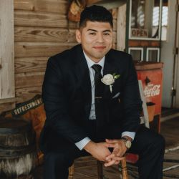
Hector
Cordova
8 year military veteran
Signal support system specailist.
Professional Exeriance
NCR Corporation, Customer engineer.
Tech and Cyber Security
Code Fellows, ITF+(2023), Net+(2024), Sec+ (Exp. 2024)
https://github.com/Hector2024
https://www.linkedin.com/in/hector-a-cordova/

Slide 9
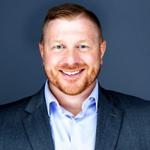
William
Baur
12 year military veteran
Linux, Windows, System Admin, Teaching
Bachalors degree in Finance
Depaul Univeristy
Professional Exeriance
CVS (AM), Chase (BRM), Tatum (SD)
Return to tech and Cyber Security
Code Fellows, ITF+(2023), Net+ & Sec+ (Exp. 2024)
https://github.com/Wrbaur
https://www.linkedin.com/in/williamrbaur/

Slide 10

Scenario
Client
Blue Falcon Enterprise -
A fast growing AWS fullfilment facility
Maintained database
Names & Addresses
Recently Downsized Post Holiday hiring
CLIENT DATA
What we Know
Ransomware
Disgruntled Employee
Privledge Creep
FACT: Privilege creep is a gradual accumulation of unnecessary access rights, posing security risks like data leaks. Think "digital keychain overload."
Product
Consumer
How It Happened
Prior to the lay off a mid-level employee had accumulated access to information beyond their scope during busy season, To aid in It related issues.
They were replaced by a more qualified administrator who was recently hired.
Previous Lack of Cloud Security
FBA by BFE

Slide 11
Script Demo

Slide 12
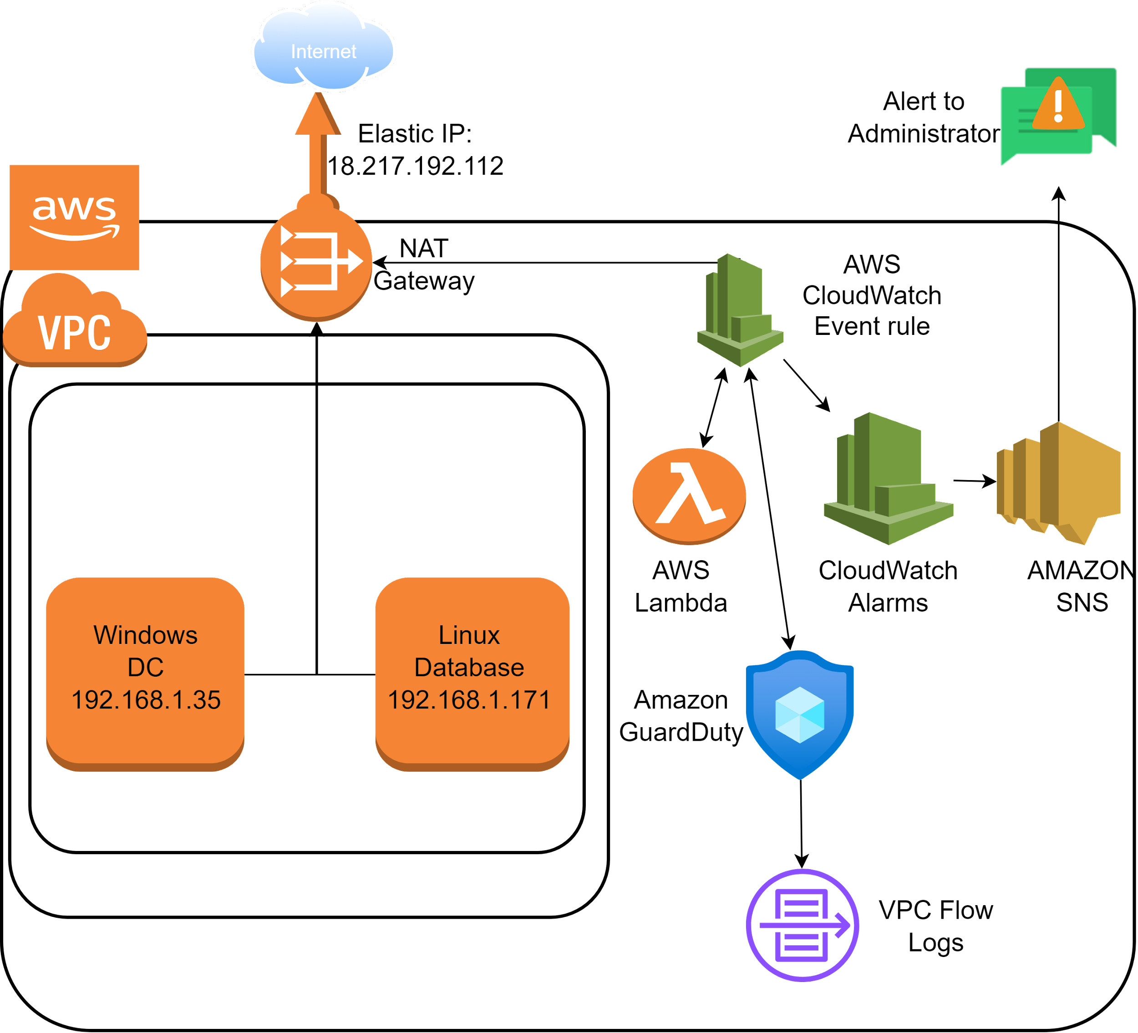
Network Diagram
Resources
AWS: Cloud computing platform offering on-demand services like storage, compute power, databases, etc. Think Netflix, but for IT resources.
VPC: Secure, isolated cloud network within a public cloud (like AWS), offering control and privacy for your resources. Think private neighborhood in a big city.
Elastic IP: Static public IP address for your cloud resources, like a portable phone number that stays the same even when you switch devices.
Subnets: Mini-networks within a larger network, like city districts within a whole city. They organize devices and boost security/efficiency.
CloudWatch:Hunts for suspicious activity in your AWS account, like a security guard for your cloud resources.
GuardDuty:Monitors and visualizes performance and security of your AWS resources, like a dashboard for your cloud health.
SNS: A messaging service that sends notifications from publishers to subscribers, like a text message service for apps and systems.
Open VPN: a secure tunnel that encrypts your internet traffic, similar to a VPN, but open-source and highly customizable. Think of it as a secret passage for your data, built with open blueprints for extra security.
IP ADDRESSES
Windows Domain Controller: 192.168.1.35
Linux Database: 192.168.1.171
Nat Gateway/Elastic IP: 18.217.192.112

Slide 13
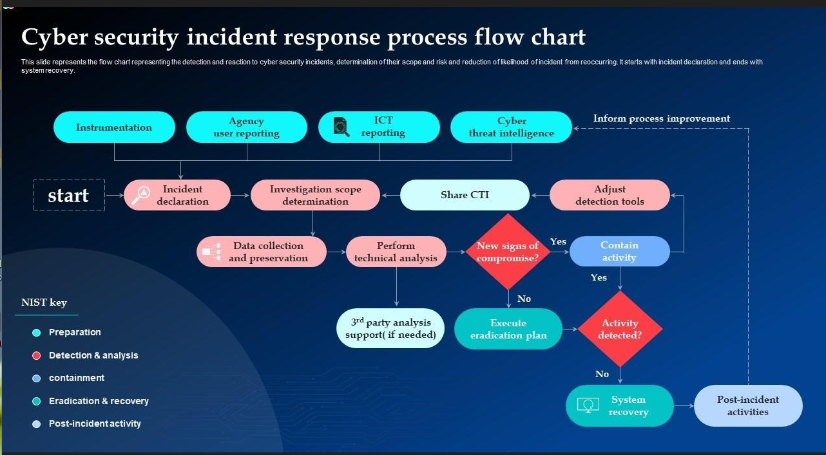

Slide 14
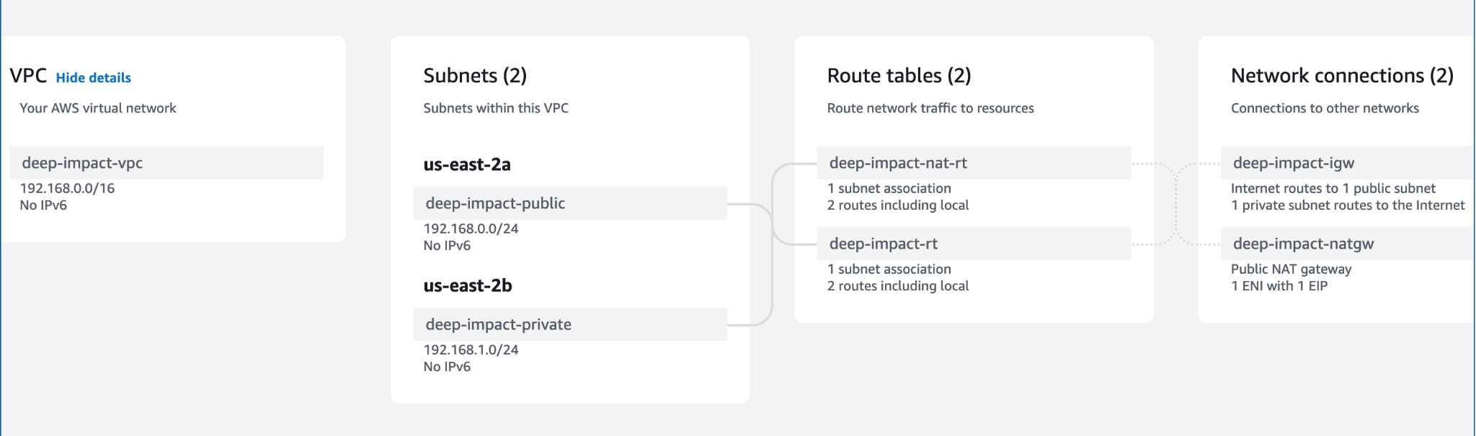
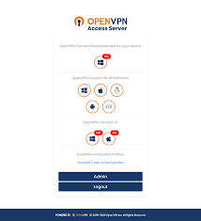
VPC/VPN Demo

Slide 15

Compliance
System Hardening
crucial for organization to stay within the requirements and regulations
3 Automated Scripts
Time Limit for idle RDP
Prevent the use of Onedrive
CIS Level 2
Here you could describe the detile if you need itHere you could describe the detile if you need it
Demo

Slide 16


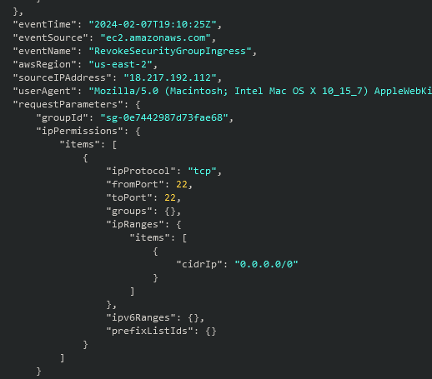

SIEM / Log aggregation system

Slide 17
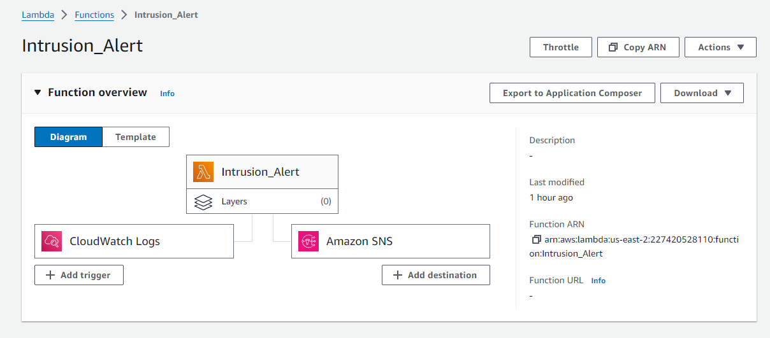
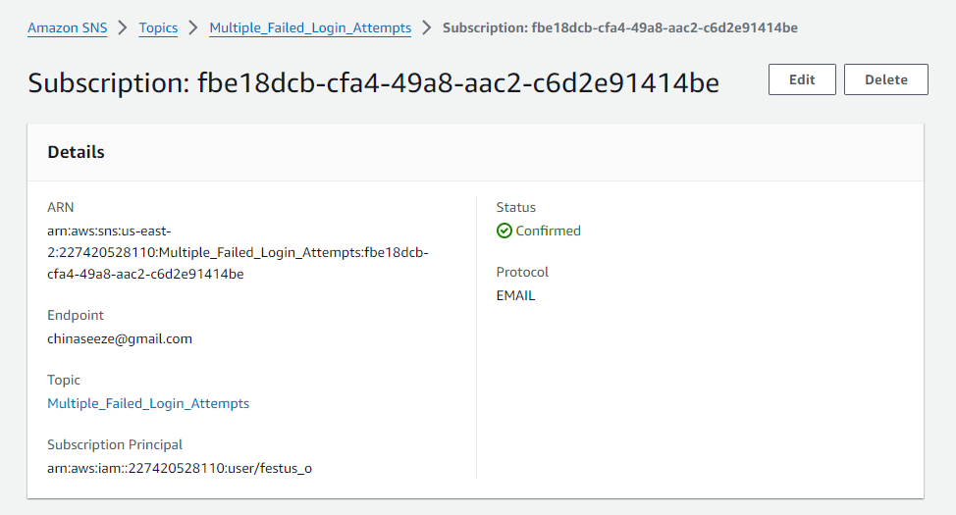
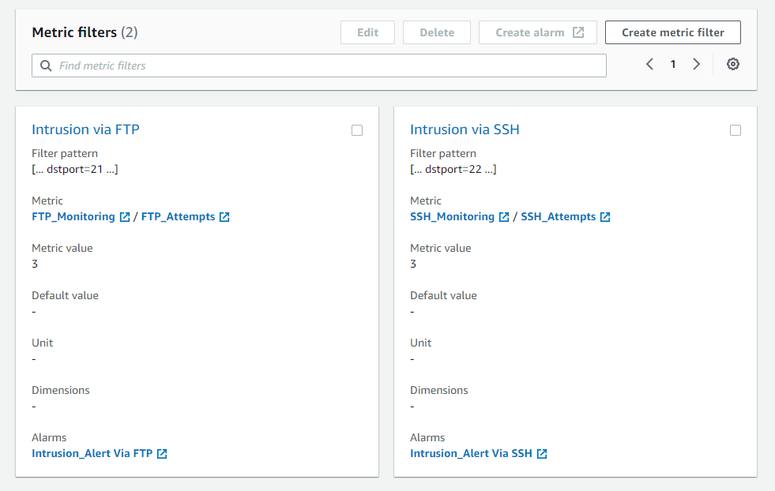
Intrusion Detection
Lambda Function monitors CloudWatch Logs for information matching triggers
Uses SNS to notify appropriate individual(s)

Slide 18

Thank You
from all of us at
D.E.E.P. Impact

Slide 19
Questions?

